Slide 1
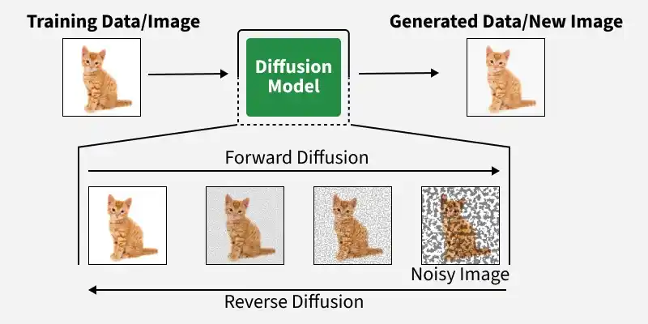
Diffusion Models: Generating Reality
Diffusion Process: These models work by adding Gaussian noise to an image (forward) and learning to reverse the process to generate a clear image from scratch.
Stable Diffusion (SD 3.5 / SDXL 2026): In 2026, these are used for Medical Report Augmentation (visualizing text descriptions) and Synthetic Agriculture Data (creating training images for rare crop diseases in KPK).
Visualization: Essential for "What If" scenarios—visualizing how a crop will look if a specific pest spreads or how a tumor might respond to treatment.

Slide 2
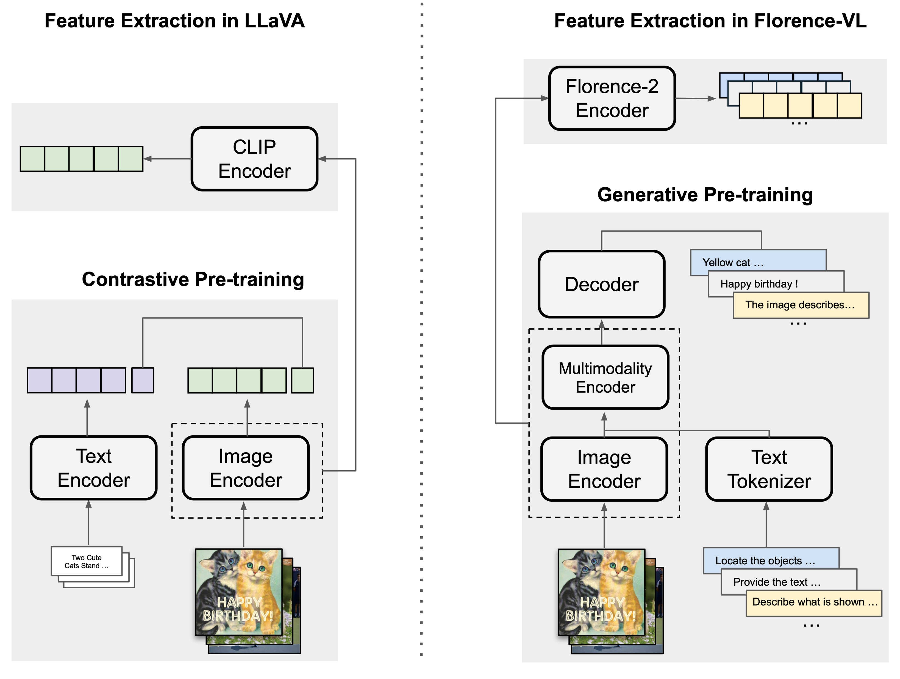
Multimodal Giants: LLaVA, Florence-2, and Beyond
LLaVA (Large Language-and-Vision Assistant): Connects a vision encoder (like CLIP successors) with a powerful LLM to enable "conversational sight."
Florence-2: Microsoft’s sequence-to-sequence foundation model that excels at high-precision tasks like segmentation and OCR in one unified framework.
Visual Agents: Models like Qwen2-VL can now act as agents, "seeing" a computer screen and clicking buttons to complete tasks autonomously.

Slide 3

Beyond Accuracy: RAGAS & LLM-as-Judge
RAGAS: The 2026 gold standard for RAG evaluation. It measures Faithfulness (is the answer grounded in context?), Answer Relevancy, and Context Precision.
LLM-as-Judge: Using a larger "Reasoning Model" (like GPT-5 or DeepSeek-V3) to grade the performance of smaller models.
Faithfulness Metric:$Faithfulness=\frac{\left|Claims in Answer supported by Context\right|}{\left|Total Claims in Answer\right|}$

